Slide 1

Basic Details of the Team and Problem Statement
Ministry/Organization Name: Ministry of Environment
Problem Statement Title : E-Waste Facility Locator
Team Name : Web Wizards Team Leader Name : Anuprita Mhapankar PS Code : 1392
Problem Statement: Website that tells you the location of the nearest e-waste collection and recycling facility. Offers educational pop-ups on the harmful components of your e-waste and their effects on the environment and human health if not disposed correctly. There could be an option to input the model of your old device and earn credit points relative to the amount of precious metals recovered from the device if disposed correctly.
Institute Name : Vivekanand Education Society's Institute of Technology Institute Code (AISHE) : 3185
Theme Name : Smart Automation

Slide 2
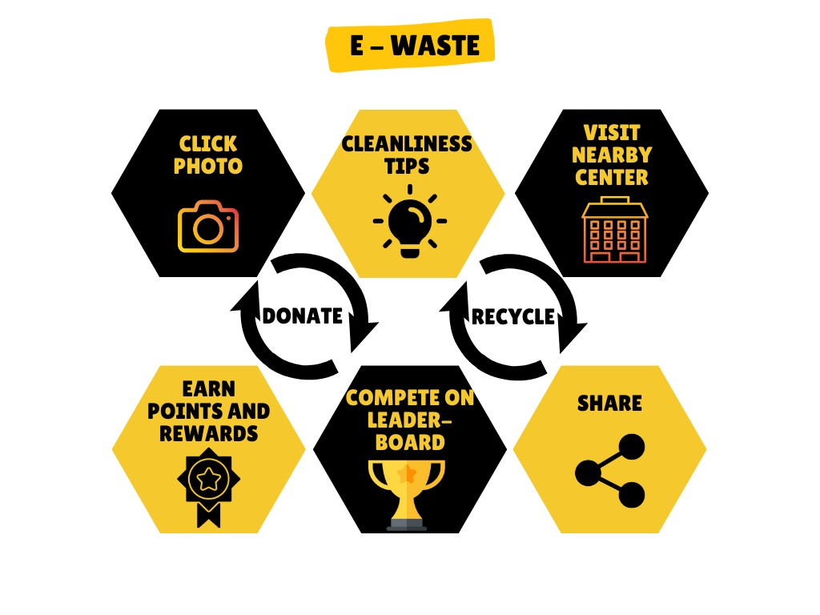
Idea / Approach Details
2
Idea : GADGET-GREEN
Gadget-Green is an innovative website designed to address the critical issue of electronic waste (E-Waste) disposal. It serves as a one-stop solution for users looking to dispose of their E-Waste responsibly while also educating them about the environmental and health impacts of improper disposal.
E-Waste Collection Locator: Gadget-Green provides users with a user-friendly interface to locate the nearest E-Waste collection and recycling facilities. Users can input their location or use geolocation services to find the most convenient drop-off points.
2. Educational Pop-ups: The website offers educational pop-ups that inform users about the harmful components present in E-Waste and their adverse effects on the environment and human health when not disposed of correctly.
3. Device Model Input and Credit Points: Users can input the model of their old electronic devices, such as smartphones or laptops by clicking images. Gadget-Green calculates credit points based on the amount of precious metals that can be recovered from these devices when recycled.
Tech Stack
Front-End : HTML, CSS, JavaScript, Next.js, React.js, Express.js
Back-End : Node.js, Python, TensorFlow
Database : Firebase, MySQL, MongoDB
Machine learning : Python Libraries
HIGHLIGHTS
User-friendly interface.
Geolocation services to detect nearby centres.
Image detection through Machine learning.
Automated report generation
Credit points and rewards
Reward by tree plantation
Donation along with recycling.
Educational popups and creating awareness

Slide 3
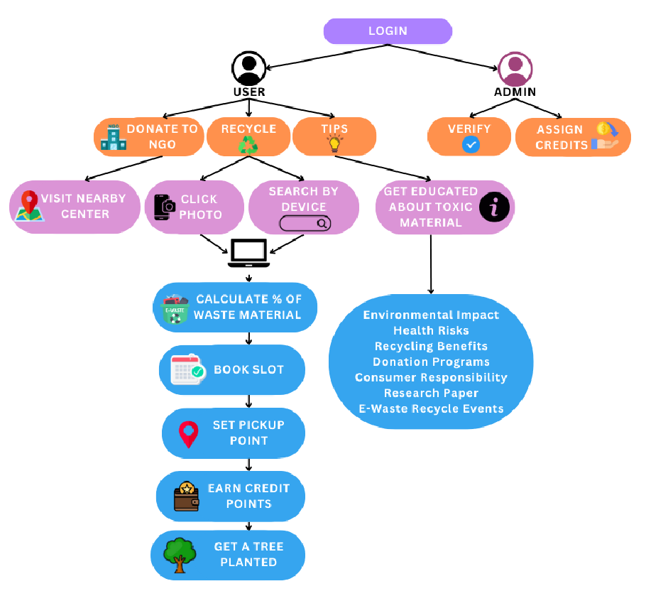
STEP1: User logins through username and password. Here, we can use API by connecting databases like Firebase with our application to provide real time authentication. STEP 2: Dashboard is displayed where user can check history, credit scores, recent activities and user details. User will be provided 3 options OPTION 1: Donate – User can donate old electronic devices to NGO’s. Hence, our web app will take input of user location and locate the nearest NGO center by automatic geolocation services. OPTION 2: Know about E-Waste – Educational popup of e-waste management and hazards. OPTION 3: Locate E-Waste centre- Here, first user will be asked to input name of the electronic device along with location of user. User can also upload the image of the electronic device which will be autodetected by machine learning feature. Then an autogenerated report will be displayed which will contain data like 1. % harmful metal in the device. 2. its hazardous impact on environment. 3. % recyclable material in the device etc. Next, Address and time slots of nearby e-waste recycling centres will be displayed where he/she can visit and handover the electronic device. Admin will assign credit points to user relative to the amount of precious metals recovered from the device if disposed correctly. Users with more than 100 credit points will earn exciting rewards or rewarded by planting tree.
3
USE CASE

Slide 4
Team Member Details
4
Team Leader Name: Anuprita Mhapankar BTECH INFT
Team Member 1 : Pranav Pol
BTECH INFT
Team Member 2 Name : Eesha Chavan
BTECH INFT
Team Member 3 Name : Shravani Rasam
BTECH INFT
Year II
HTML | CSS | JavaScript | MySQL | Java | C | C++|Figma |Canva
Year II
HTML | CSS | Java | C | C++
Year II
HTML | CSS | MySQL | C |Figma |Canva
Year II
HTML | CSS | Java | C | C++ | Python |MySQL |Figma |Canva
Team Member 4 Name : Siddhant Sathe
BTECH INFT Year II
Team Member 5 Name : Vedang Wajge
BTECH INFT Year II
Team Mentor 1 Name: Ms. Pooja Shetty
HTML | CSS | Java | C | C++ | Python | MySQL
HTML | CSS | Java | C | C++ | Python | MySQL
Academic: Expertise : Web development
Domain Experience (in years): 14

Slide 5


CERTIFICATES

Slide 6

CERTIFICATES

Slide 7

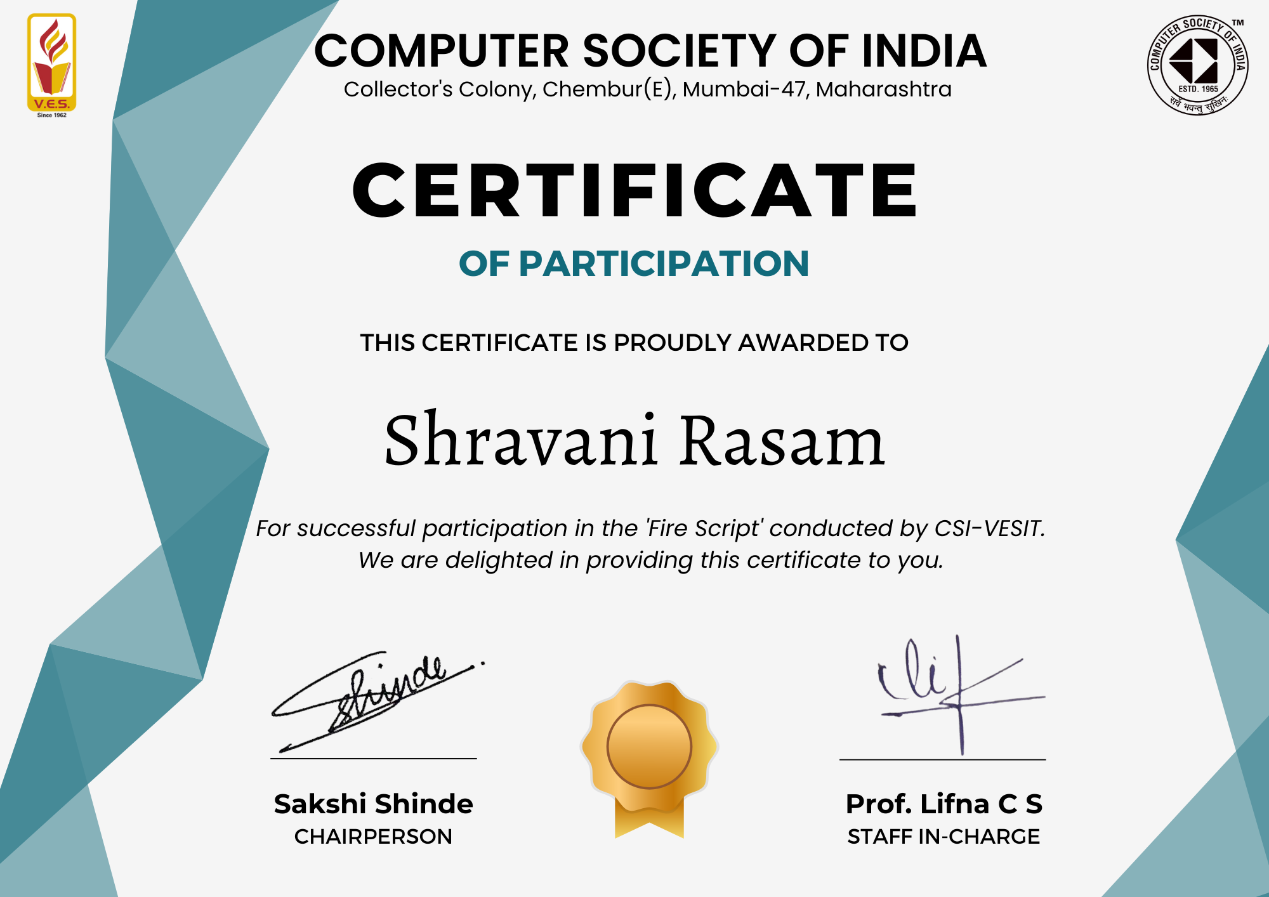
CERTIFICATES
FIGMA
FIREBASE

